Slide 1
Phishing Detection Tool Using Machine Learning
D.Tejaswi
AP22110011503
CSE-Y
April 19, 2025

Slide 2
Understanding Phishing and Its Significance
.
Problem Statement: Phishing attacks deceive users into revealing sensitive information by imitating legitimate websites or trusted contacts through emails. This project aims to develop a machine learning-based tool that detects both phishing URLs and phishing emails in real-time by analyzing key features. The tool offers a user-friendly web interface where users can input URLs or email content to check if they are safe or malicious, thereby enhancing online security and user awareness.
Objective: Develop an intelligent system to classify emails and URLs as "Phishing" or "Safe" with high precision and recall.
Need for ML:
Manual detection is unscalable and error-prone.
Machine learning enables real-time, adaptive classification of phishing artifacts.

Slide 3
Challenges and Solutions
Challenge: Gmail API authentication complexity.
Solution: Simplified with gapi-script, tokenClient.
Challenge: Noisy email text (e.g., HTML tags).
Solution: Regex-based cleaning, robust preprocessing.
Challenge: URL false positives(some safe URLs were wrongly flagged as phishing).
Solution: I fixed this using a hybrid ML + heuristic approach, where keywords also helped score URLs.
Challenge: Dataset imbalance (URL: 116K phishing vs. 100K safe).
Solution: Stratified sampling, feature engineering.

Slide 4
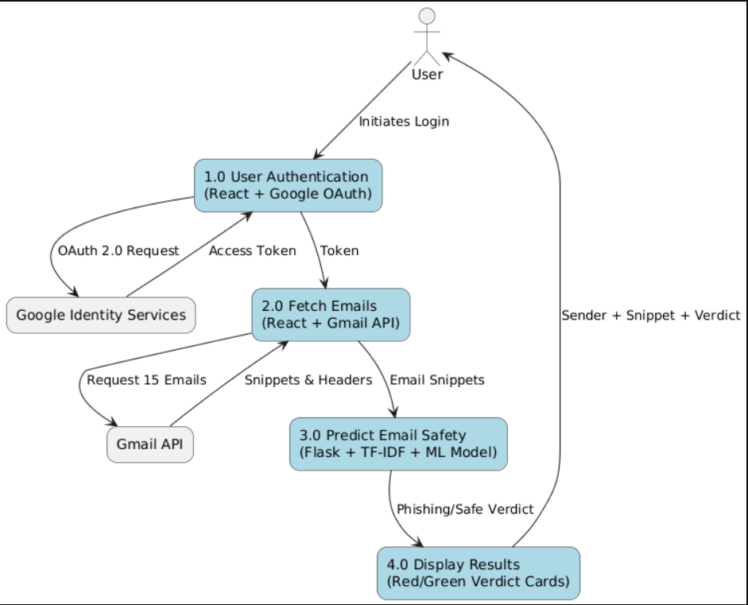
Email Phishing Detection Workflow

Slide 5
Email Phishing Detection Workflow: Gmail Access Setup and Email Fetching
Authentication using Google Identity Services
Users authenticate through OAuth 2.0 flow
Once authenticated, secure access is granted to their Gmail inbox
Steps to Create OAuth Credentials:
Open Google Cloud Console and create a new project
Enable the Gmail API under "APIs & Services" and Navigate to "OAuth consent screen" and configure the app details
Under "Credentials", create OAuth 2.0 Client ID and Choose application type as "Web application"
Add the redirect URI provided by Google Identity Services and Copy the generated Client ID and integrate it in the frontend
Fetching Emails via Gmail API
After authentication, the app uses the Gmail API to retrieve emails
Specifically fetches the 15 most recent emails from the inbox
Axios GET requests are made with the access token for secure data retrieval

Slide 6
Email Phishing Detection Workflow:
Preprocessing the Email Content
Converts email text to lowercase for uniformity
Removes URLs, punctuation, and special characters using regular expressions
Feature Extraction using TF-IDF Vectorizer
Transforms text data into numerical vectors
Phishing Detection using Logistic Regression
A trained logistic regression model analyzes the feature vectors
Emails with prediction probability greater than 0.5 are classified as phishing
Model achieves around 95 percent accuracy, 0.94 precision, and 0.96 ROC-AUC score
Displaying Results through React UI
Each email is presented with sender information and a short snippet
Verdict is shown using visually distinct cards

Slide 7
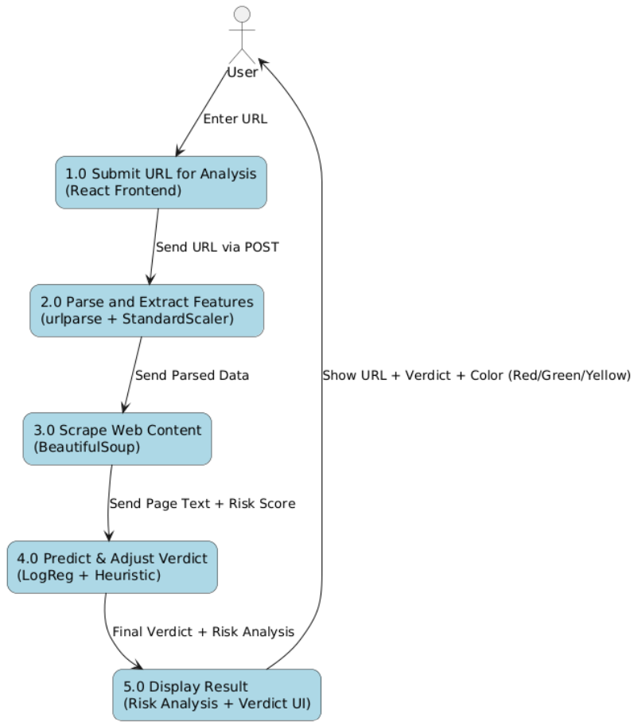
URL Phishing Detection Workflow

Slide 8
URL Phishing Detection Workflow– Input to Feature Extraction
Step 1: User Input
User enters a URL into the input field on the interface
URL is sent to the server using Fetch API with a POST request to the /predict-url route
Step 2: Feature Extraction
urlparse is used to break down the URL into domain, path, and query components
Extracted features include: – Length of the URL – Whether HTTPS is used – Number of subdomains
Step 3: Web Content Analysis
BeautifulSoup is used to scrape the webpage’s content
Counts the frequency of keywords such as “login” and other suspicious terms
Applies a heuristic scoring system: – High risk (score > 3) – Moderate risk (score 1–3) – Low risk (score 0)

Slide 9
URL Phishing Detection Workflow– Model Prediction and Result Visualization
Step 4: Prediction using Hybrid Model
Logistic Regression model is applied on the extracted and scaled features
Achieves approximately 92 percent accuracy in classifying URLs
Heuristic score is used alongside the model output to adjust the final risk level
Step 5: Output Display through React UI
Final result is displayed on the frontend
Shows whether the URL is safe, suspicious, or phishing
Risk is visually represented using color-coded cards: – Red for phishing – Yellow for suspicious – Green for safe

Slide 10
Performance Metrics
Email Model (Phishing.csv): Accuracy: 90.5%, Precision: Safe (0.86), Phishing (1.00).,Recall: Safe (1.00), Phishing (0.77).,F1-Score: Safe (0.93), Phishing (0.87),Support: Safe (113), Phishing (77),Macro Avg: Precision (0.93), Recall (0.88), F1 (0.90)
URL Model (cleaned_url_dataset.csv):
Accuracy: 99.98%.
Dataset: 116,286 phishing, 100,944 safe URLs.
Evaluation:
Stratified 80-20 split.
Confusion Matrix: Minimal false positives/negatives for URLs.

Slide 11
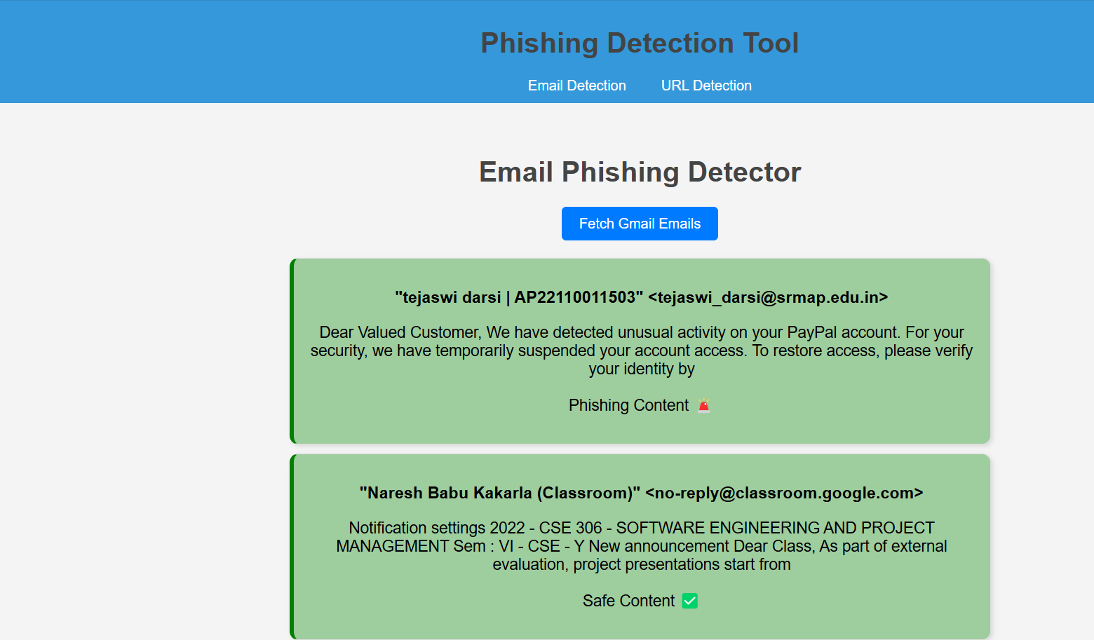
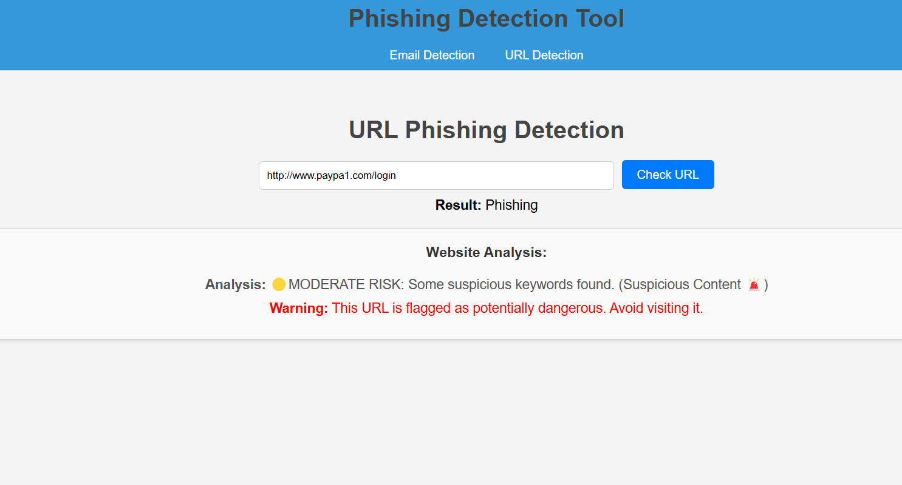
OUTCOMES

Slide 12
THANK YOU

